Slide 1


Healthcare
Analytics
for Doctor
Visits
Ingoude
Company
Exploratory Data Analysis using Python, Pandas, NumPy, Matplotlib, Seaborn, and Google Colab.
PRESENTED BY
Aryan Vishwakarma
2030
DEPARTMENT
Insights
Healthcare Analytics

Slide 2

02
Project Overview
OBJECTIVE & ANALYTICAL QUESTIONS
Objective: Analyze the key factors influencing the number of doctor visits using a real-world healthcare dataset of 5,190 patient records.
Analytical Questions:
• What demographic factors (age, gender) affect visit frequency?
• How do health status and chronic conditions relate to visits?
• Does income or insurance coverage influence healthcare utilization?
• What is the impact of illness duration and reduced activity on doctor visits?
• Which variables show the strongest correlation with visit counts?

Slide 3

03
Dataset
Overview
OVERVIEW OF DATASETS, SYSTEMS, AND INFORMATION USED
The dataset contains 5,190 records sourced from a structured healthcare survey on doctor visit behavior. Originally comprising 13 columns, one unnamed index column (Unnamed: 0) was removed, leaving 12 clean analysis variables.
Key variables include: number of doctor visits (target), age, gender, income, health status, illness severity, activity limitations, chronic conditions, and insurance coverage status.
Data types span both numerical and categorical formats, enabling multi-dimensional exploratory analysis across demographic and health-related dimensions.
5,190
Total patient records analyzed

Slide 4




01
02
03
04
INDEX
REMOVAL
MISSING-VALUE
CHECK
DUPLICATE
CHECK
CATEGORICAL REVIEW & DESCRIPTIVE STATS
Removed the unnamed index column (Unnamed: 0) generated during CSV export. This step ensured only the 12 meaningful analysis variables were retained for processing.
Reviewed categorical variables (gender, insurance, illness) for consistency. Computed descriptive statistics including mean, median, and standard deviation for numeric fields.
Performed a systematic null-value audit across all 12 variables. No missing values were detected, confirming the dataset was complete and ready for analysis.
Scanned all 5,190 records for exact duplicate rows. No duplicates were found, validating the integrity and uniqueness of each patient visit record.
The dataset of 5,190 records underwent a structured four-step cleaning pipeline. After removing the redundant index column, checks confirmed zero missing values and zero duplicates, yielding a clean, analysis-ready dataset of 12 variables.
Data Cleaning

Slide 5

Exploratory Data Analysis
VISIT DISTRIBUTION
8
01
Analysis of 5,190 patient records reveals a right-skewed distribution of doctor visits. The majority of patients report 0–2 annual visits, while a smaller proportion accounts for high-frequency visits. Histograms and box plots confirm significant variability across the dataset, with outliers present at the upper end of the visit count range.
KEY VARIABLES ANALYZED
GENDER, AGE & ILLNESS
Female patients show slightly higher average visit counts compared to males. Age displays a positive trend with visit frequency, as older individuals tend to seek care more often. Illness severity, measured on a categorical scale, is a notable differentiator — patients reporting higher illness levels consistently show elevated visit counts across all age groups.
02
VISIT DISTRIBUTION
Doctor visit counts range from 0 to 9+, with most patients visiting 0–2 times per year.
HEALTH, INCOME & INSURANCE
DEMOGRAPHICS
Gender and age comparisons reveal older patients and females tend to report more frequent visits.
Self-reported health status inversely correlates with visits — poorer health drives higher utilization. Income shows a mild negative association, suggesting lower-income patients visit slightly less. Insurance coverage and chronic conditions both increase visit frequency, with insured and chronically ill patients recording the highest average annual doctor visits in the dataset.
03
HEALTH & CONDITIONS
Illness severity, health status, insurance coverage, and chronic conditions all influence visit frequency.

Slide 6
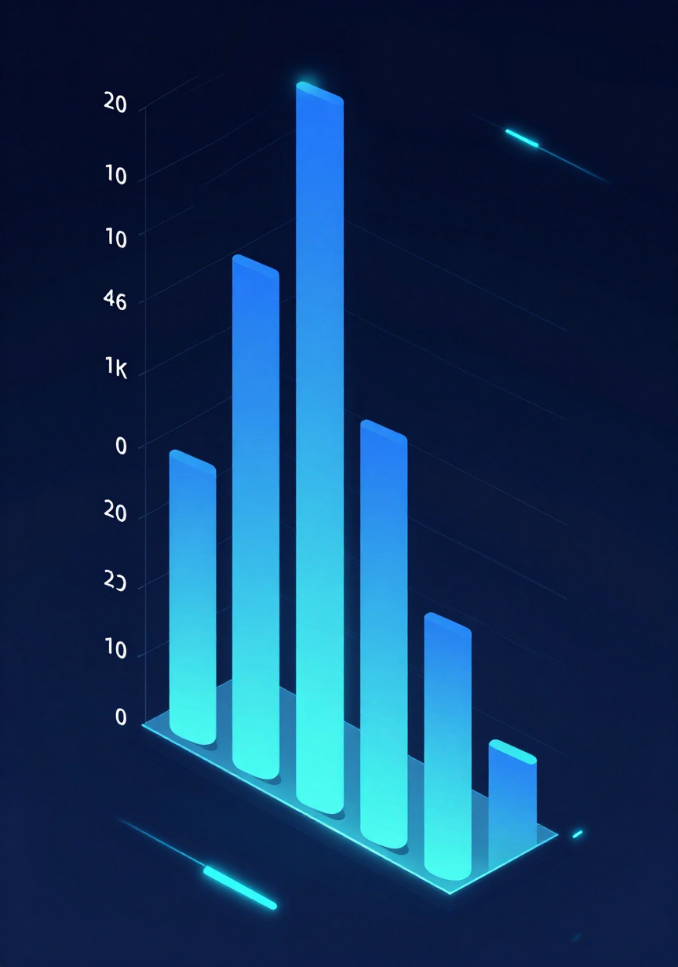

06
Correlation Analysis
PEARSON CORRELATIONS WITH DOCTOR VISITS — STRONGEST TO WEAKEST
Reduced Activity (0.403): The strongest positive correlation — patients with reduced daily activity visited doctors most frequently.
Illness (0.185): Moderate positive link; more illness episodes correlate with more visits.
Health Status (0.149): Poorer self-reported health is associated with higher visit frequency.
Age (0.124): Older patients tend to visit doctors slightly more often.
Income (−0.077): A weak negative correlation; higher income is marginally associated with fewer visits, though the effect is small.
Reduced activity is by far the dominant predictor, suggesting physical functioning is the key driver of healthcare utilization in this dataset.
0.403
STRONGEST CORRELATION (REDUCED ACTIVITY)

Slide 7


07
Key Insights
HEALTH & ACTIVITY FACTORS VS. INCOME — INTERPRETING ASSOCIATIONS CAREFULLY
Reduced activity (0.403) is the strongest predictor of doctor visits among all variables analyzed.
Health and activity factors consistently show stronger associations with visit frequency than income (-0.077).
Illness (0.185), self-rated health (0.149), and age (0.124) each contribute meaningfully to visit patterns.
All findings reflect correlations only — no causal claims can be drawn from this exploratory analysis.

Slide 8
08
Visualizations
SELECTED PROJECT CHARTS AND VISUAL OUTPUTS FROM THE ANALYSIS
01
02
03
04
CORRELATION HEATMAP
COMPARATIVE ANALYSIS
AGE & INCOME PLOTS
VISIT DISTRIBUTION
Histogram showing frequency distribution of doctor visits across 5,190 records
Scatter and box plots exploring age (0.124) and income (-0.077) vs. visit frequency
Heatmap revealing reduced (0.403) as strongest predictor of doctor visits
Bar charts comparing visits by gender, insurance status, and chronic conditions

Slide 9

09
Conclusion
KEY
SUMMARIZED FINDINGS & PRACTICAL INTERPRETATION
Analysis of 5,190 patient records revealed that health status and physical activity are the strongest predictors of doctor visit frequency. Reduced activity (r=0.403) showed the highest correlation, followed by illness days (r=0.185) and poor health (r=0.149). These findings suggest behavioral and clinical factors drive healthcare utilization more than socioeconomic variables like income.
TAKEAWAY SUMMARY
Reduced activity is the top driver of doctor visits
Illness frequency and poor health are key indicators
Age and income show modest but notable influence
Insurance status does not strongly predict visit frequency
Findings support patient-centered, preventive care strategies

Slide 10




Thank You!
Limitations
& Future
Work
Healthcare
Analytics
Limitations: Correlation is not causation — observed relationships do not imply direct cause and effect. Self-reported data may introduce bias. Cross-sectional design limits temporal inference.
Future Work: Develop predictive models (regression, ML). Apply statistical hypothesis testing. Expand dataset for broader generalizability.
Python, Pandas, NumPy
Matplotlib, Seaborn, Google Colab
10
Avx Sharma — Doctor Visits EDA
of 10

